Slide 1

Computer Network
Transmission Media

Slide 2
Transmission Media
Transmission media is a pathway that carries the information from sender to receiver. We use different types of cables or waves to transmit data. Data is transmitted normally through electrical or electromagnetic signals.
An electrical signal is in the form of current.
An electromagnetic signal is series of electromagnetic energy pulses at various frequencies.
signals can be transmitted through copper wires, optical fibers, atmosphere, water and vacuum
Transmission media is also called Communication channel.

Slide 3
Types of Transmission Media
Transmission media is broadly classified into two groups:
Wired or Guided Media or Bound Transmission Media
Wireless or Unguided Media or Unbound Transmission Media

Slide 4
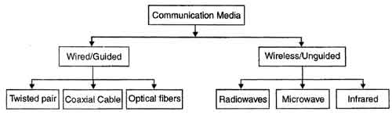
Types of Transmission Media

Slide 5
Wired or Guided Media or Bound Transmission Media
Bound transmission media are the cables that are tangible or have physical existence and are limited by the physical geography.
Popular bound transmission media in use are twisted pair cable, co-axial cable and fiber optical cable.
Each of them has its own characteristics like transmission speed, effect of noise, physical appearance, cost etc.

Slide 6
Wireless or Unguided Media or Unbound Transmission Media
Unbound transmission media are the ways of transmitting data without using any cables. These media are not bounded by physical geography. This type of transmission is called Wireless communication.
Nowadays wireless communication is becoming popular.
Wireless LANs are being installed in office and college campuses.
This transmission uses Microwave, Radio wave, Infra red are some of popular unbound transmission media.

Slide 7
Transmission Media Factors
Bandwidth: It refers to the data carrying capacity of a channel or medium. Higher bandwidth communication channels support higher data rates.
Radiation: It refers to the leakage of signal from the medium due to undesirable electrical characteristics of the medium.
Noise Absorption: It refers to the susceptibility of the media to external electrical noise that can cause distortion of data signal.
Attenuation: It refers to loss of energy as signal propagates outwards. The amount of energy lost depends on frequency. Radiations and physical characteristics of media contribute to attenuation.

